Slide 1

Design Patterns
LESSON 2
BEHAVIORAL PATTERNS

Slide 2
Classification
Creational patterns provide various object creation mechanisms, which increase flexibility and reuse of existing code.
Singleton, Factory Method, Abstract Factory, Builder, Prototype
Structural patterns explain how to assemble objects and classes into larger structures while keeping these structures flexible and efficient.
Adapter, Bridge, Composite, Decorator, Façade, Flyweight, Proxy
Behavioral patterns handle how objects interact: communication, dependencies, isolation.
Chain of responsibility, Command, Iterator, Mediator, Memento, Observer, State, Strategy, Template Method, Visitor
Creational Patterns
Structural Patterns
Behavioral Patterns
Notes:
Creational = mecanisme de creare a obiectele pentru a oferi flexibilitate si reutilizare a codului
Structural = asamblarea obiectelor si a claselor, integrarea lor structuri mai largi, lasand totusi flexibilitate. Aici o sa fie mai grele exemplele, pentru ca nu o sa lucram pe structuri largi
Behavioral = se refera mai mult la algoritmi si asignarea responsabilitatilor intre obiecte

Slide 3
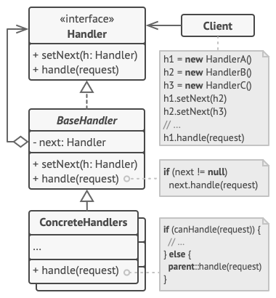
Chain of responsibility
Problem: sequential logic that needs to be executes in a particular logic, a lot of guard conditions (if something, then stop execution)
Solution: transform separate logic to handler objects, each handler in the chain can pass further to another handler, can stop the execution or can process the request

Slide 4
Chain of responsibility in a few words + examples from open-source projects
Unique handlers, each handler knows about its successor
Can become difficult if it’s a long chain of handlers, you can have performance issues
Hierarchical structure, but a handler is not aware of the whole hierarchy, it just knows the next handler
There might be the risk of leaving a request unprocessed
.NET: HTTP pipeline, Microsoft.Practices.EnterpriseLibrary.Logging.Logger
Spring Security filter chain
java.util.logging.Logger#log()
javax.servlet.Filter#doFilter()
NodeJS: express middlewares https://expressjs.com/en/guide/using-middleware.html

Slide 5
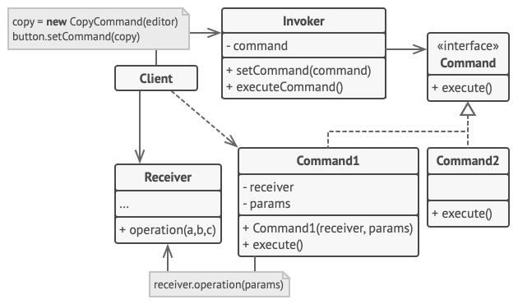
Command
Problem: Components coupled too tight with business logic
Solution: Create intermediary objects that are able to handle commands, separate invocation from performing
Notes:
Separate invocation from performing. You delegate work to other objects
Real world example light and switch
Receiver = the one who receives the command
Invoker = the one who sends the command
The client does not execute the command directly on the receiver, but it sends it to the Command through the Invoker.
Macro command = it receives multiple receivers in the constructor
On short, the implementation forces you to have a method in all commands, “execute”, “run”, and you have the receiver object and the parameters available, you just have to call the given command
You can use for operation Java reflection or C++ pointers

Slide 6
Command in a few words + examples from open-source projects
Encapsulate in an object all the data required to perform an action (command)
Sender is decoupled from the processor => MAINTAINABILITY
Together with Memento you can implement undo functionality
Macro command = it receives multiple receivers in the constructor
Java: java.lang.Runnable, javax.swing.Action
C#: System.Windows.RoutedEventArgs
Extra docs: https://sourcemaking.com/design_patterns/command

Slide 7
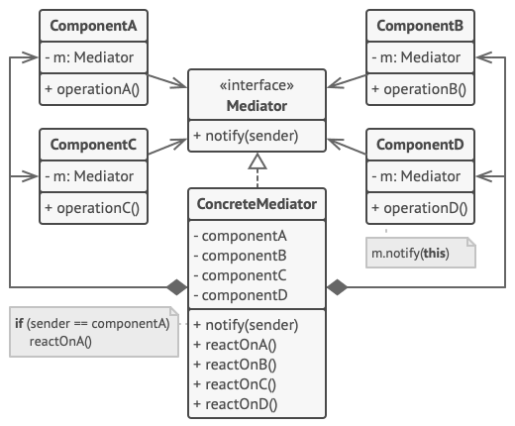
Mediator
Problem: a lot of dependencies between objects, “spaghetti code”
Solution: create a mediator that is responsible to handle requests and react with needed updates on other components
Notes:
Mediator eliminates communication between objects. It forces them to communicate through a mediator.
As the dictionary says, it occupies a middle position.
Common use cases: chat application, UI forms, think of a login/register form, or create/edit something form.
The pitfall here is to create the so-called God object, knows too much, does too much
Only the mediator knows about colleagues/components, they don’t know about each other.
The mediator is responsible of defining the interaction between components.
The main advantages are that it minimize inheritance and it has loose coupling.

Slide 8
Mediator in a few words + examples from open-source projects
Eliminate dependencies between a set of system components
Defines interaction between components
Components are very often called “colleagues”
Classic pitfall: God object
C#: System.Threading.Timer
Java:
scheduleXXX() methods of java.util.Timer
scheduleXXX() methods of java.util.concurrent.ScheduledExecutorService
java.lang.reflect.Method#invoke()
Mediator.js: https://www.npmjs.com/package/mediator-js

Slide 9
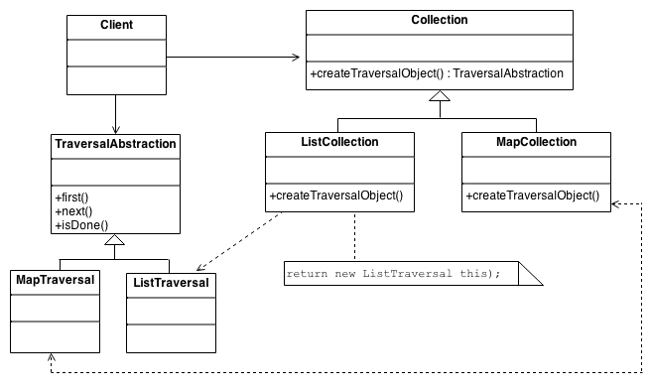
Iterator
Problem: the need for a unified way to traverse any data structures, regardless of its underlying representation
Solution: defined standard traversal protocol in order to decouple your data from the algorithms
Notes:
We use iterators a lot in out daily lives. How we look into nature with our eyes, how a secretary knows all the files, how we decide to get dressed, how we switch between TV channels.
Iterator can traverse Composites, in your implementations.
It can be slower

Slide 10
Iterator in a few words + examples from open-source projects
Suitable for complex data structure
Fail fast vs fail safe
Does not expose collection structure, so no index, like in a for loop
Can also be implemented for security reasons
C#: System.Collections.Ienumerable, System.Data.IDataReader
Java: java.util.Iterator
foreach (in several languages)
Generators (Python and JavaScript)

Slide 11
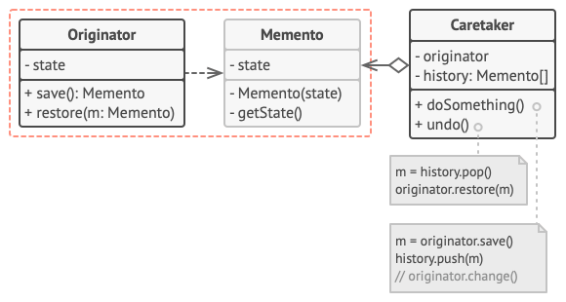
Memento
Problem: need to restore previous states of an object (undo, rollback operations)
Solution:
Memento – immutable, nested class (there are other implementations as well)
Caretaker – decides when and what to restore
Originator – saves its state to memento

Slide 12
Memento in a few words + examples from open-source projects
Used to restore a previous state
Memento must be immutable, so no setter methods
Classic use case: undo functionality
Several implementations: nested classes, interface (find more details here)
Java:
java.io.Serializable
javax.faces.component.StateHolder
java.util.Date
C#: Sytem.Runtime.Serialization.Iserializable

Slide 13
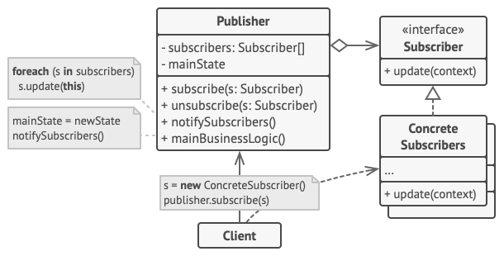
Observer
Problem: need to dynamically react on some events happening in the app, need some objects to follow other objects for a limited time or in some specific cases
Solution: identify the object that is observable (observable/publisher/subject), maintain a list of objects depending on it (observers/subscribers) that need to be automatically notified about any changes in the state
Notes:
The Observer is a design pattern where an object (known as a subject) maintains a list of objects depending on it (observers), automatically notifying them of any changes to state.
The Observer pattern requires that the observer (or object) wishing to receive topic notifications must subscribe this interest to the object firing the event (the subject).
The Publish/Subscribe pattern however uses a topic/event channel which sits between the objects wishing to receive notifications (subscribers) and the object firing the event (the publisher). This event system allows code to define application specific events which can pass custom arguments containing values needed by the subscriber. The idea here is to avoid dependencies between the subscriber and publisher.
This differs from the Observer pattern as it allows any subscriber implementing an appropriate event handler to register for and receive topic notifications broadcast by the publisher.

Slide 14
Observer in a few words + examples from open-source projects
Java: java.util.EventListener
C#: Sytem.IObservable
Android: https://developer.android.com/reference/android/database/DataSetObservable
jQuery: jquery.on(), jquery.trigger(), jquery.off()
React Redux: https://react-redux.js.org/
RxJS: https://rossbulat.medium.com/rxjs-a-simple-introduction-32fb48f52a67
Tip for presentation: compare with Publish/Subscribe pattern
All subscribers need to follow the same interface, so that the Subject/Publisher can interact uniformly with them
Usually, 1 to many relationship (1 observable with many subscribers)
Change subscribers at runtime
Can make debugging difficult, can lead to unexpected updates

Slide 15
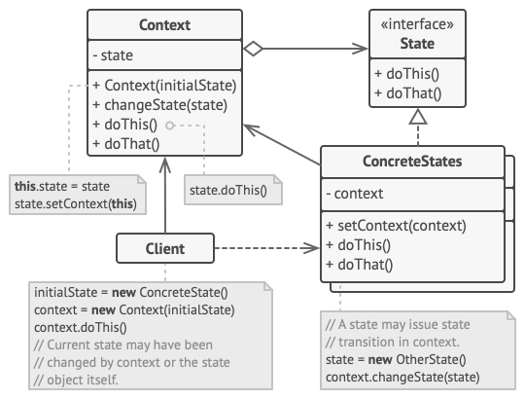
State
Problem: multiple states of an object that are changing very often, multiple conditionals for behavior based on state values, duplicated code within different states and transitions between states
Solution: extract each state in a separate class that follows an interface
Notes:
Very similar to finite state machines
Separate WHAT from WHERE, you can add new states, the context will stay the same
When implementing, it’s important to identify the behavior that is state dependent
It is an abstract class or interface based pattern, each state represents a concrete class, while the context is unaware of the states

Slide 16
State in a few words + examples from open-source projects
Java: javax.faces.lifecycle.LifeCycle#execute(), controller by FacesServlet
Angular open-source project, developed by the Angular team at Google
https://blog.mgechev.com/2021/01/18/design-pattens-in-open-source-projects-part-i/
C++ open-source multi-simulation game
https://cppdepend.com/blog/?p=357
Extra docs: https://sourcemaking.com/design_patterns/state
Alter an object’s behavior when its state changes
Very similar to finite state machine concept
All states have to implement some update method (even if it does nothing, see audio player example)
Very similar to Strategy pattern, but with different intents
Notes:
The implementation of the State pattern builds on the Strategy pattern. The difference between State and Strategy is in the intent. With Strategy, the choice of algorithm is fairly stable. With State, a change in the state of the "context" object causes it to select from its "palette" of Strategy objects.
States know about each other, they are linked and they create a flow like in finite state machines, whereas in Strategy the algorithms have no connection with one another

Slide 17
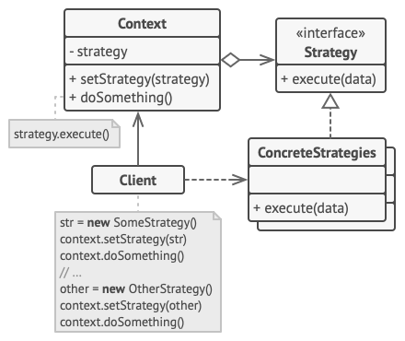
Strategy
Problem: a lot of algorithms maintained in the same class (open-closed principle not respected), a class that does a thing in a lot of different ways
Solution: split each “way of doing the same thing” (algorithm) into a separate class (a strategy)
Notes:
Based on composition, context has a field where is stores a strategy. The strategies have no links with one another, they do not switch between one another, like states in State pattern.
You can switch algorithms at runtime.
Allows you to extract different behaviors that are applied in the same context.
It’s usually something that the user can modify (payment method, routing algorithm, sort/filter)
Bridge, State and Strategy, have a similar structure, being based on composition, but it’s important to notice the intent of the pattern, the exact problem that it solves.

Slide 18
Strategy in a few words + examples from open-source projects
Define a family of algorithms, making them interchangeable
Based on composition
Strategies are meant to be changed at runtime
Use cases: validation, filter, sort, payment method, auth method, storing strategies
Java:
java.util.Comparator#compare() javax.servlet.Filter#doFilter()
C#:
System.Collections.Generic.IComparer
Notes:
In functional programming, it can be easier to implement strategies, because you have callbacks, you can send functions as parameters that can do the work.

Slide 19
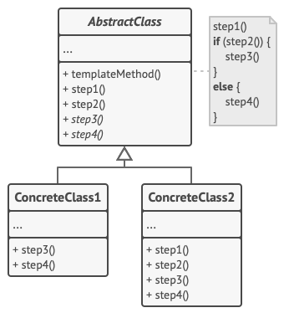
Template
Problem: very similar algorithms implemented in different classes, that do not reuse their common parts, steps
Solution: build an abstract class on top, with
a template method that cannot be overwritten
some steps that need to be implemented
default steps that can be overwritten
Notes:
The main benefit of this pattern is to remove duplicated code.
Template pattern let you define particular steps of an algorithm, but not the whole algorithm or its structure.
Use this pattern when you have almost identical steps in an algorithm, with some small differences.
Sometimes, your algorithm is not already split in steps, you might need first to identify the steps.
Then, you must identify which steps are common, which are different.
It is based on inheritance, abstract class to hold template method and the steps that have to be defined.
The template method has the desired structured, steps, order. The template method must not be overwritten (use final).
“Hooks” or “placeholders” are customizable steps on a class.
“The Hollywood principle” – “don’t call us, we’ll call you”, this inverted control structure, in the sense that the client adds some customization options to an already existing template, like we do in frameworks.
Template Method uses inheritance to vary part of an algorithm. Strategy uses delegation to vary the entire algorithm.
Strategy modifies the logic of individual objects. Template Method modifies the logic of an entire class.
Factory Method is a specialization of Template Method. ?

Slide 20
Template in a few words + examples from open-source projects
Benefit: remove duplicated code
Based on inheritance
Invariant (standard) steps of an algorithm Variant (customizable, hooks, placeholders) steps
Read about the Hollywood Principle ☺
Java:
java.util.AbstractMap
java.io.InputStream
javax.servlet.http.HttpServlet
C#: System.Web.UI.Page
Spring: AbstractController, RestTemplate
Django: https://jonathanchristopher1199.medium.com/django-rests-template-method-pattern-and-other-patterns-plugged-in-374dcf168723
Notes:
With the Hollywood principle – We allow low level components to hook themselves into a system – But high level components determine when they are needed and how. – High level components give the low-level components a “don’t call us, we’ll call you” treatment.
Just like a framework, which defines invariant pieces of an architecture and defined placeholders for all necessary or interesting client customizations.

Slide 21
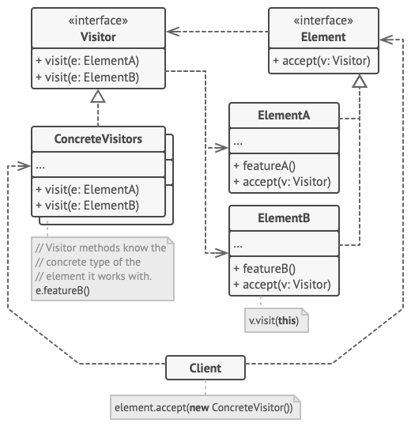
Visitor
Problem: need to add features without changing existing objects
Solution: separate algorithm in visitor class and add accept method for each element
Notes:
A pattern that focuses on adaptability by externalizing changes. It makes it easier to add new Visitors and it is even encouraged, that’s the point of the pattern
Concepts:
Separate object from algorithm
Usually, you use it when you want to add new features, but you don’t want to modify the current implementation of elements
The Visitor object holds our changes, our business logic, not our elements
You want to implement a new functionality, but you don’t want to go and update each object with your logic
Implementing visitor, you don’t pollute your objects with business logic
If you add a new Visitor, you don’t have to modify existing classes at all
Design:
Interface based
It’s rather a mindset that you begin with. This can be, of course, a pitfall, because you might plan for adaptability and add flexibility that is not necessary or will never be used
Actors: Visitor, Element, Concrete visitors, concrete elements
Visitor knows about all Elements
Summary:
You expect changes to happen, but you are not sure what
Can add minor complexity, but not much
You externalize changes
One benefit related to unit tests: existing tests won’t fail because you added new functionality

Slide 22
Visitor in a few words + examples from open-source projects
Add new functionalities without changing all existing objects
Externalize changes (only visitor object implements changes)
Pitfall: you plan for adaptability and can create flexibility that it’s just not going to be used
Double dispatch
Java:
java.lang.model.element.Element and ElementVisitor
(but it’s rather obscure, more for the language)
C#: System.Linq.Expressions.ExpressionVisitor
Spring: org.springframework.beans.factory.config.BeanDefinitionVisitor

